Slide 1
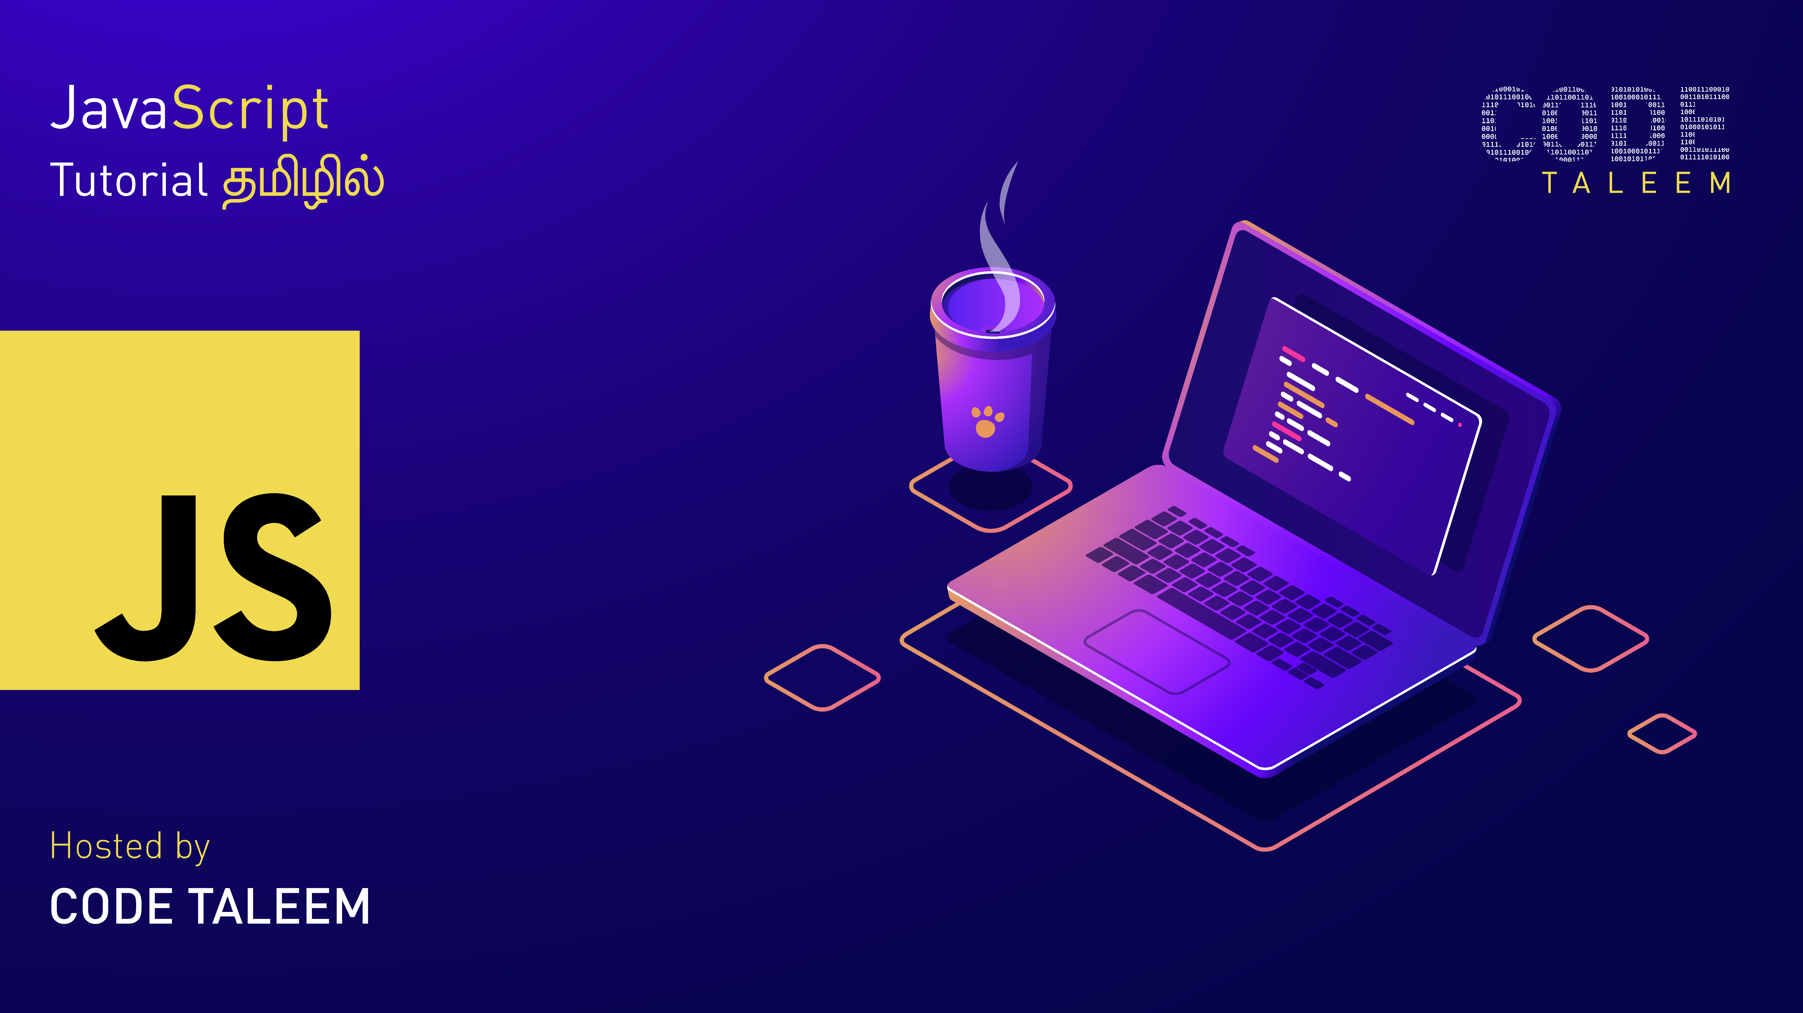

Slide 2

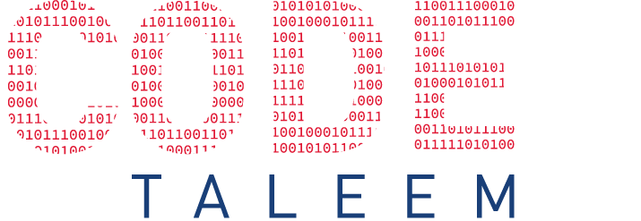
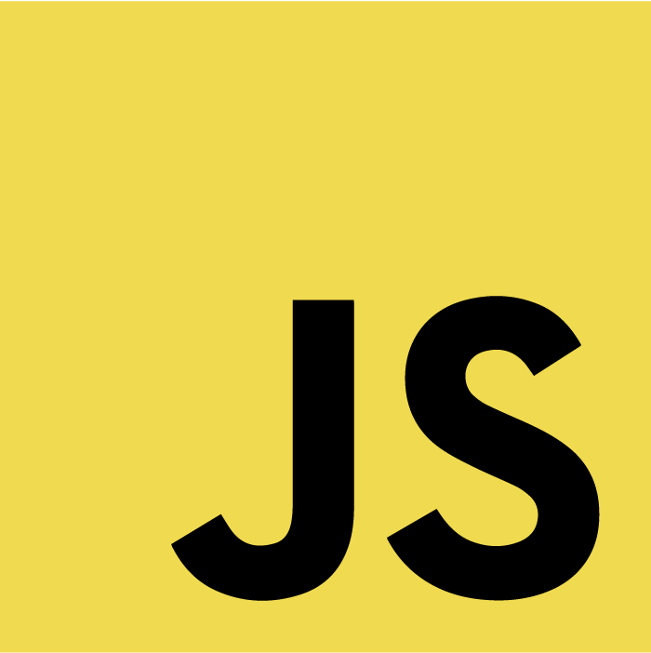
What is JavaScript
Why learn JavaScript
Where to use
CHAPTER 1
Introduction of JS
History JS
Benefits of JS

Slide 3
What is JavaScript
JavaScript was initially created to “make web pages alive”.
The programs in this language are called scripts. They can be written right in a web page’s HTML and run automatically as the page loads.
Scripts are provided and executed as plain text. They don’t need special preparation or compilation to run.
In this aspect, JavaScript is very different from another language called Java.
Why learn JavaScript
Where to use
History JS
Benefits of JS

Slide 4
What is JavaScript
It’s the most popular programming language.
JavaScript is, without question, the default language of the Internet.
JavaScript is Easy to Learn
JavaScript also Affects Big Data and the Cloud “JavaScript Object Notation (JSON) is the go-to standard for data exchanges on today’s internet.”
JavaScript is Versatile Front-end: Angular, React, Vue, etc.. Back-end: Node.js
Why learn JavaScript
Where to use
History JS
Benefits of JS

Slide 5
What is JavaScript
Create Interactivity between web page and User.
A JavaScript can be used to validate form data before it is submitted to a server.
JavaScript manipulate HTML and CSS, creating, removing and changing HTML, dynamically applying new styles to your page.
Dynamic Complex Web Application
Why learn JavaScript
Where to use
History JS
Benefits of JS

Slide 6

What is JavaScript
Why learn JavaScript
Where to use
History JS
Benefits of JS

Slide 7
What is JavaScript
Speed - Client-side JavaScript is very fast because it can be run immediately within the client-side browser.
Simplicity – Easy to learn and Implement
Popularity – used anywhere web
Interoperability – JS plays nicely with other languages and can be used in a huge variety of applications.
Server Load - Being client-side reduces the demand on the website server.
Rich Interface - Gives the ability to create rich interface
Why learn JavaScript
Where to use
History JS
Benefits of JS

Slide 8
Prerequisites
IDE
Version
CHAPTER 2
prerequisites
Browser Support

Slide 9
Prerequisites
HTML – Hyper Text Markup Language
Hypertext Markup Language is the standard markup language for documents designed to be displayed in a web browser
CSS - Cascading Style Sheets
CSS describes how HTML elements are to be displayed on screen, paper, or in other media
IDE
Version
Browser Support

Slide 10
Prerequisites
Visual Studio Code Webstrom Atom Sublime Text Notepad++
IDE
Version
Browser Support

Slide 11
Prerequisites
JS Initial Release – Dec 1995
ECMAScript Initial Release – Jun 1997
ECMAScript Latest Release – Jun 2020
Latest Version – ES11 or ECMAScript 2020
IDE
Version
Browser Support

Slide 12
Prerequisites
ECMAScript 3 is fully supported in all browsers.
ECMAScript 5 is fully supported in all modern browsers.
Enable JS instructions. <noscript></noscript>
IDE
Version
Browser Support

Slide 13
Inline JS
External JS
External JS advantage
CHAPTER 3
How to use

Slide 14
Inline JS
Inline JavaScript can be achieved by using Script tag inside the body of the HTML, and instead of specifying the source(src=”…”) of the JavaScript file in the Script tag, we have to write all the JavaScript code inside the Script tag.
Syntax: <script> // JavaScript Code </script>
External JS
External JS advantage

Slide 15
Inline JS
We can create external JavaScript file and embed it in many html page.
It provides code re usability because single JavaScript file can be used in several html pages.
Let's create an external JavaScript file that prints “Hello Code Taleem” in a alert dialog box.
External JS
External JS advantage

Slide 16
Inline JS
It helps in the reusability of code in more than one HTML file.
It allows easy code readability.
It is time-efficient as web browsers cache the external js files, which further reduces the page loading time.
It enables both web designers and coders to work with html and js files parallelly and separately, i.e., without facing any code conflictions.
The length of the code reduces as only we need to specify the location of the js file.
External JS
External JS advantage

Slide 17
Statements
Semicolons
Comments
CHAPTER 4
Code Structure
Syntax

Slide 18
Statements
In HTML, JavaScript statements are "instructions" to be "executed" by the web browser.
Example:
Document.getElementById(“demo”).innerHTML = “Hello Code Taleem”;
This statement tells the browser to write "Hello Code Taleem" inside an HTML element with id="demo”
Most JavaScript programs contain many JavaScript statements. The statements are executed, one by one, in the same order as they are written.
Semicolons
Comments
Syntax

Slide 19
Statements
Semicolons separate JavaScript statements. Add a semicolon at the end of each executable statement:
When separated by semicolons, multiple statements on one line are allowed.
Example:
var a, b, c; a=1; b=2; c=a+b;
Semicolons
Comments
Syntax

Slide 20
Statements
Single Line Comments: Single line comments start with //.
Any text between // and the end of the line will be ignored by JavaScript (will not be executed).
Example: var x = 5; // Declare x, give it the value of 5
Multi-line Comments: Multi-line comments start with /* and end with */.
Any text between /* and */ will be ignored by JavaScript.
Example: /* The code below will set the id = ”name” inner text as a Code Taleem */ document.getElementById(”name").innerHTML = ”Code Taleem";
Semicolons
Comments
Syntax

Slide 21
Statements
JavaScript syntax is the set of rules, how JavaScript programs are constructed:
var x, y, z; // How to declare variables x = 5; y = 6; // How to assign values z = x + y; // How to compute values
Semicolons
Comments
Syntax

Slide 22
innerHTML
document.write()
console.log()
CHAPTER 5
JS Output
alert(), prompt(), confirm()

Slide 23
innerHTML
The innerHTML property sets or returns the HTML content (inner HTML) of an element.
To access an HTML element, JavaScript can use the below method.
Syntax: document.getElementById("demo").innerHTML = ”Code Taleem";
document.write()
console.log()
alert(), prompt(), confirm()

Slide 24
innerHTML
The document.write() method should only be used for testing.
the document.write() method to write the content to the current document only while that document is being parsed.
Syntax: document.write(”Code Taleem");
document.write()
console.log()
alert(), prompt(), confirm()

Slide 25
innerHTML
console.log() using for debugging purposes.
You can easily output a message or writes data to the browser console using the console.log() method.
It’s very powerful method for generating detailed output.
Syntax: console.log(”Code Taleem");
document.write()
console.log()
alert(), prompt(), confirm()

Slide 26
innerHtml
alert dialog boxes to display the message or output data to the user.
Syntax: alert(”Code Taleem");
________________________________
It shows a modal window with a text message, an input field for the visitor, and the buttons OK/Cancel.
It is often used if the user wants to input a value before entering a page.
Syntax: let name = prompt(‘What is your name?’, “Code Taleem”);
________________________________
The confirm() method displays a dialog box with a specified message, along with an OK and a Cancel button.
A confirm box is often used if you want the user to verify or accept something.
Syntax: let name = confirm(‘What is your name?’, “Code Taleem”);
document.write()
console.log()
alert(), prompt(), confirm()

Slide 27
Use Strict
Variables
let, const, var
CHAPTER 6
Use Strict & Variables
Variable Naming Conversion

Slide 28
Use Strict
The "use strict" directive was new in ECMAScript version 5.
It prevents, or throws errors, when relatively “unsafe” actions are taken. It disables features that are confusing or poorly thought out. Strict mode makes it easier to write “secure” JavaScript.
It should write in top of the page.
Variables
let, const, var
Variable Naming Conversion

Slide 29

Use Strict
A variable is a “named storage” for data.
Once store the data then refer to the data simply by naming the container.
Syntax: var a = 5;
Variables
let, const, var
Variable Naming Conversion

Slide 30
Use Strict
In c++, Java variable declaration int x=5; In JavaScript variable declaration var x=5; 2 types of scopes - Global & Local depending upon where you create your variables
________________________________
let keyword use inside a block {} cannot be accessed from outside the block: Syntax: { let x = 2; }
________________________________
Variables defined with const behave like let variables, except they cannot be reassigned: const name = “Code Taleem”; name = “Taleem Code”; // This will give an error
Variables
var, let, const
Variable Naming Conversion

Slide 31
Use Strict
You should not use any of the JavaScript reserved keywords as a variable name.
For example, break or boolean
JavaScript variable names should not start with a dollar($), hyphen(-), numeral(0-9). They must begin with a letter or an underscore character.
For example, invalid – var 789demo; / valid – var _789demo;
JavaScript variable names are case-sensitive.
For example, Name and name are two different variables. var Name = 1; var name = 2;
Variables
var, let, const
Variable Naming Conversion

Slide 32
Loosely Coupled Language
Dynamically Typed Language
Different Datatypes
CHAPTER 7
Datatypes

Slide 33
Loosely Coupled Language
JavaScript is a loosely typed language, meaning you don't have to specify what type of information will be stored in a variable in advance.
var x = 12; //number
var x = “Code Taleem”; //String
var x=true; //Boolean
Dynamically Typed Language
Different Datatypes

Slide 34
Loosely Coupled Language
Dynamically-typed languages are those (like JavaScript) where the interpreter assigns variables a type at runtime based on the variable's value at the time.
var x = 12; //number
var y = "Code Taleem"; //String
var z = true; //Boolean
document.write(typeof(x)); // Output: number
Dynamically Typed Language
Different Datatypes

Slide 35
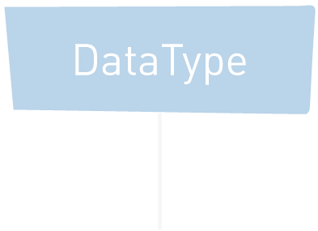
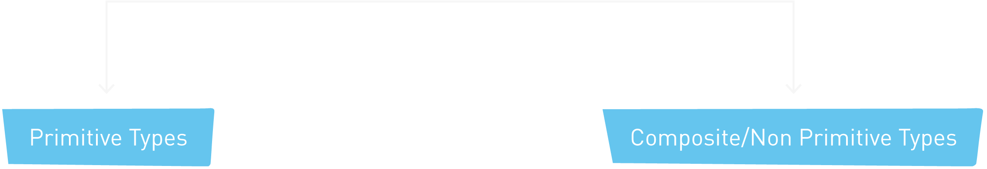
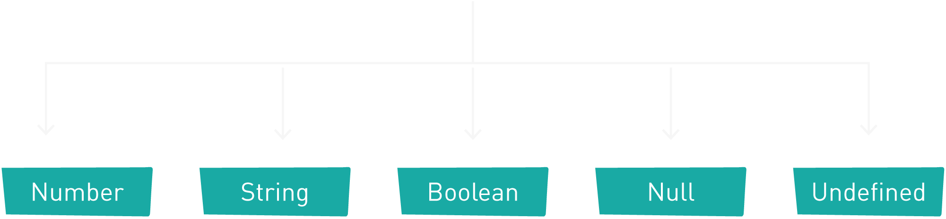
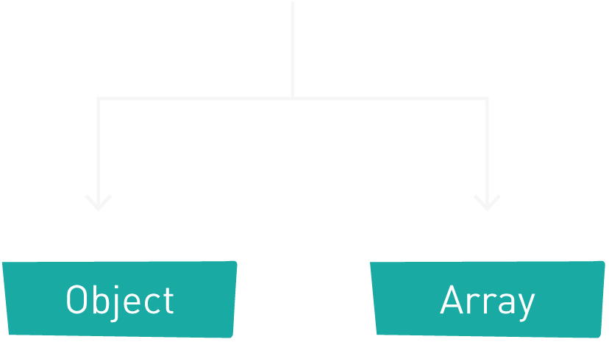
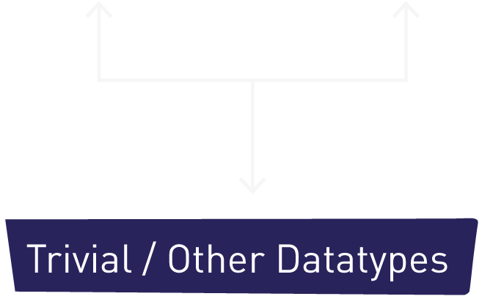
Loosely Coupled Language
Dynamically Typed Language
Different Datatypes

Slide 36
String Conversion
Numeric Conversion
Boolean Conversion
CHAPTER 8
Type Conversions

Slide 37
String Conversion
String conversion happens when we need the string form of a value.
let value = true; //Boolean value = String(value); //now value is a string “true”
Numeric Conversion
Boolean Conversion

Slide 38
String Conversion
Numeric conversion happens in mathematical functions and expressions automatically.
let str = “123”; //String let num = Number(str); //Number
Numeric Conversion
Boolean Conversion

Slide 39
String Conversion
It happens in logical operations but can also be performed explicitly with a call to Boolean(value).
Values that are intuitively “empty”, like 0, an empty string, null, undefined, and NaN, become false.
Other values become true.
alert(Boolean(1)); // true alert(Boolean(0)); // false alert(Boolean("hello")); // true alert(Boolean("")); // false
Numeric Conversion
Boolean Conversion

Slide 40
Comparison Operators
Logical Operators
Ternary Operator
CHAPTER 9
Operator/Comparison
Increment / Decrement Operator
Other Operators

Slide 41
Comparison Operators
Comparison operators are used in logical statements to determine equality or difference between variables or values.
Given that x = 6;
Logical Operators
Operator | Comparing | Returns
== | x == 8 | false
 | x == “6” | true
=== | x === 6 | true
 | x === “6” | false
!= | x != 8 | true
!== | x !==6 | false
 | x !==“6” | true
> | x > 8 | false
< | x < 8 | true
>= | x >= 8 | false
<= | x <= 8 | true
Ternary Operator
Increment / Decrement Operator
Other Operators

Slide 42
Comparison Operators
Comparison operators are used in logical statements to determine equality or difference between variables or values.
Given that x = 7 and y = 4;
Logical Operators
Operator | Condition | Returns
&& | (x < 10 && y > 1) | true
|| | (x < 5 || y > 5) | false
! | !(x == y) | true
Ternary Operator
Increment / Decrement Operator
Other Operators

Slide 43
Comparison Operators
JavaScript also contains a conditional operator that assigns a value to a variable based on some condition.
Syntax: variablename = (condition) ? value1:value2
Logical Operators
Ternary Operator
Increment / Decrement Operator
Other Operators

Slide 44
Comparison Operators
The JavaScript Increment and Decrement Operators useful to increase or decrease the value by 1.
Syntax: Increment Operator : ++x or x+ Decrement Operator: ––x or x–
Logical Operators
Ternary Operator
Increment / Decrement Operator
Other Operators

Slide 45
Comparison Operators
Assignment Operators Syntax: var x = 10;
________________________________
Arithmetic Operators Syntax: Addition(+), Subtraction(-), Multiplication(*), Exponentiation(**), Division(/), Modulus (%) var x = 10 * 2; // x value is 20
________________________________
String / Concatenate Operators Syntax var txt1 = ”Code"; var txt2 = ”Taleem"; var txt3 = txt1 + " " + txt2; // txt3 value is Code Taleem
________________________________
Bitwise Operators Bit operators work on 32 bits numbers.
Logical Operators
Ternary Operator
Increment / Decrement Operator
Other Operators

Slide 46
What is Control Statement
Conditional Control Statement
Iterative Control Statement
CHAPTER 10
Control Statement

Slide 47
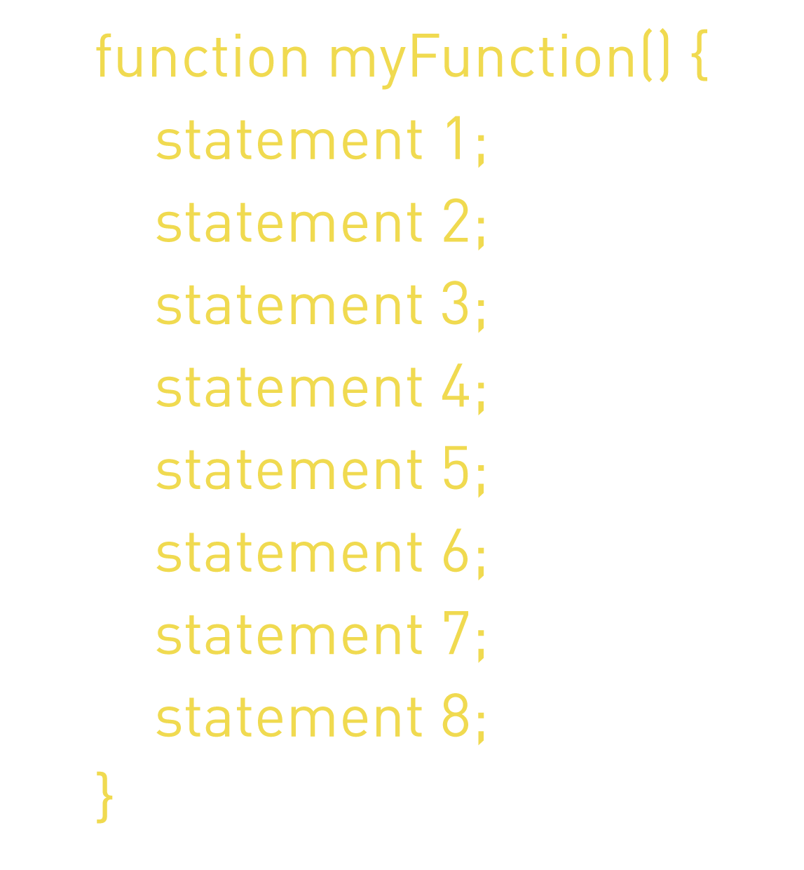
What is Control Statement
Control structure actually controls the flow of execution of a program.
JavaScript execution start from the first line into the last line of that JS code.
It is also known as Control Statement or Flow control statement.
Conditional Control Statement
Iterative Control Statement

Slide 48
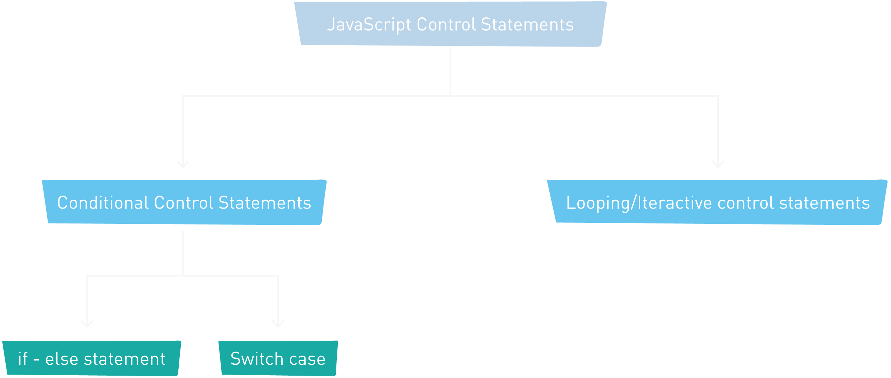
What is Control Statement
Conditional Control Statement
Iterative Control Statement

Slide 49
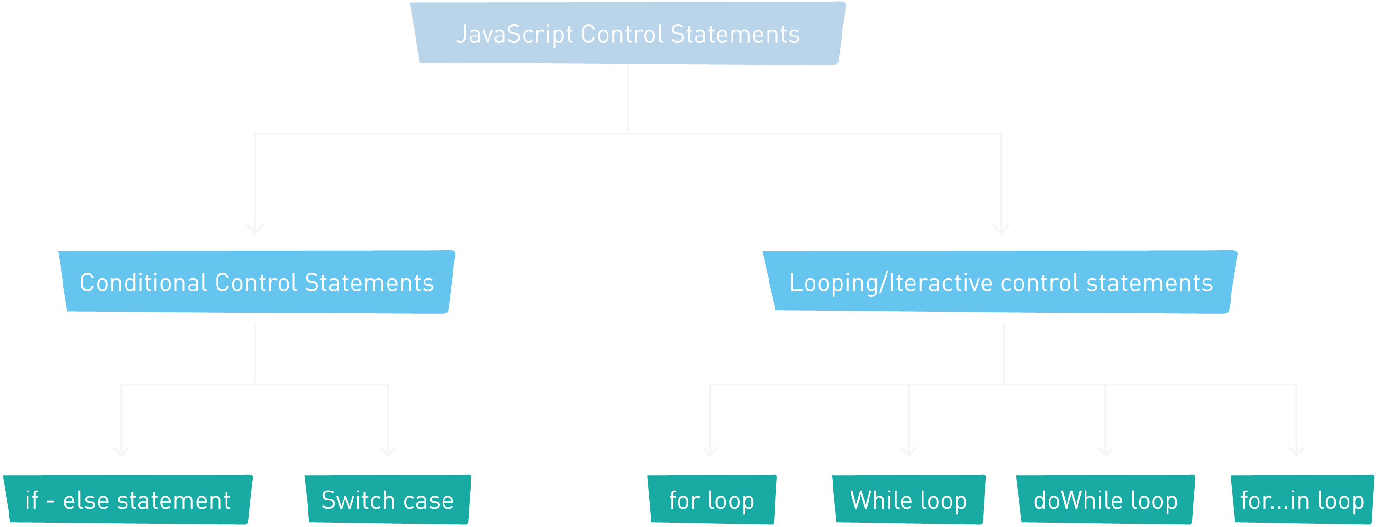
What is Control Statement
Conditional Control Statement
Iterative Control Statement

